Slide 1
UNIT-III
Input Devices and Printers
1

Slide 2
THE KEYBOARD
A computer keyboard is a hardware device that functions in accordance to the instructions made by the user. It comprises circuits, switches and processors that help in transferring keystroke messages to the computer.
Keyboard skill is call Keyboarding.
Keyboard connector
Keyboards are generally plugged into the rear of the CPU, on the motherboard, using a purple PS/2 connector, or on USB port.
2

Slide 3
TYPES OF KEYBOARD
1) PC-XT keyboard
- this keyboard has only one side communication. The keyboard can send information to the system but the system was not allowed to send any information or command to the keyboard
Number of key-83
Mode of communication: unidirectional
Size of Enter and shift keys were small.
No indicators to show status of num_lock, caps_lock and scroll_lock.
2) PC-AT keyboard
Number of keys:84
Mode of communication: bidirectional
Numberic keypad moved away from alphabet keys
Most of the keys that were indicated only with arrow symbols
3

Slide 4
3) Enhanced PC-AT keyboard
Number of keys: 101
Additional navigation and control keys.
12 function keys in separate row along top were
provided
Provided additional CTRL and ALT keys on both sides of space bar for easy access
4

Slide 5
WIRED KEYBOARD
1) DIN
The older style is the larger of the two, called the 5 pin DIN keyboard connector.
DIN stands for Deutsche industries norm, a german
standards
It was used on the first pcs and became standard connection through about the mid-1990s
2) PS/2
The smaller is the 6-pin,so called “mini-DIN”
keyboard connector.
The smaller connector was introduced on the IBM model PS/2 and is therefore sometimes called PS/2 connector.
5
-

Slide 6
3) USB
It is the most common type of interface and has become the standard interface on all current computers.
One of the benefits of a well defined specification like the USB is the abundance of device drivers available in most modern operating systems.
It is easy for operating system designers to include
functioning drivers for devices.
6

Slide 7
WIRELESS KEYBOARD
A wireless keyboard is a computer that allows the user to communicate with computers, tablets or laptops with the help of radio frequency, infrared, and Bluetooth technology.
It is based on infrared technology use light waves to transmit signals to other infrared enabled devices.
The radio transmitter is inside the wireless keyboard.
The radio receiver plugs into a keyboard port or USB port.
Once the receiver and transmitter are plugged in, the computer recognizes the keyboard and mouse as if they were connected via cable.
7

Slide 8


STANDARDISED LAYOUT (QWERTY)
A standard computer keyboard has about 80-110 keys.
Most keyboards use the QWERTY layout, named for the first six keys in the top row of letters
4 8 9
1
2 3 5 6
7
0
Q W E R T Y A S D F G H
Z
U I O P J K L
X C V B N M , .
SPACE
8

Slide 9
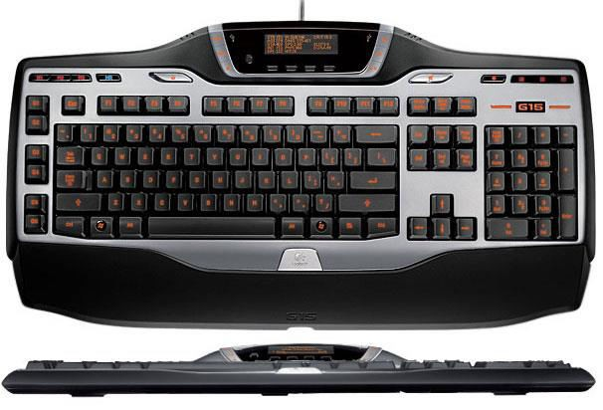
The Keyboard - Standard Keyboard Layout
Most keyboards have keys arranged in five groups:
Alphanumeric keys
Numeric keypad
Function keys
Modifier keys
Cursor-movement keys

Slide 10
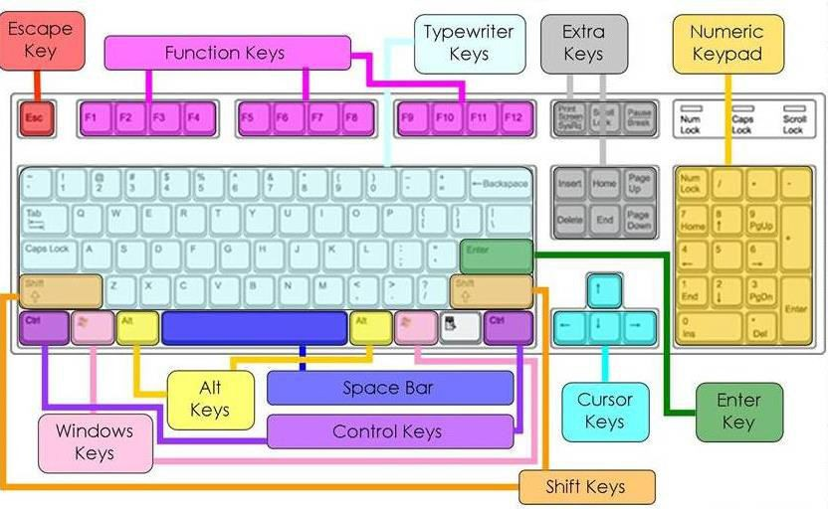
PARTS OF KEYBOARD

Slide 11

ALTERNATE KEY
Also called ALT key
Executes commands with other key(s)

Slide 12
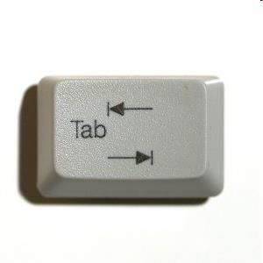
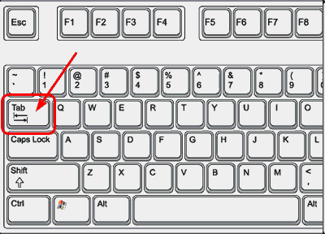
TAB KEY
Moves the cursor/insertion point to a preset position. Used to indent paragraphs or to type columns.
Tab

Slide 13
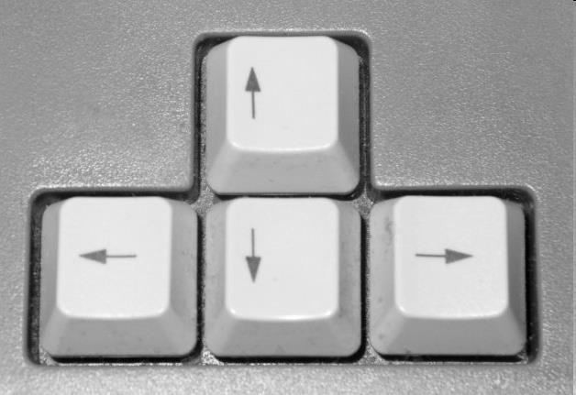
ARROW KEYS
Move the cursor/insertion point in the direction indicated by the arrow on each key

Slide 14
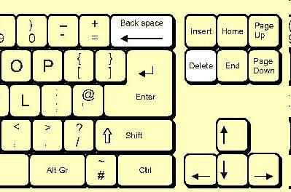

BACKSPACE KEY
Removes (erases) the character to the left of the insertion point. Use the right little finger to operate the key.
ackspa

Slide 15
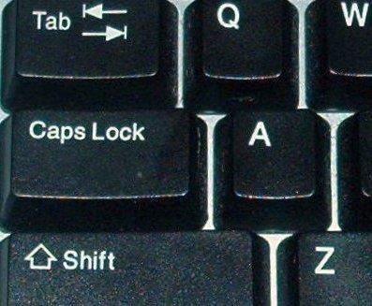
CAPS LOCK KEY
Used for keying a string of (three or more) all capital letters. Capitalizes all letters when used. If caps lock mode is in use and a letter is keyed while holding down a shift key, a lowercase letter will be keyed.

Slide 16
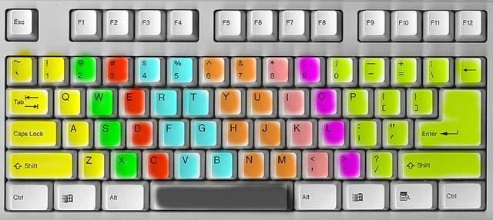
FUNCTION KEYS
Special keys located at the top of the keyboard (F1, F2, F3, F4, etc.) that are used alone or with the CTRL, ALT, and Shift keys to execute software commands

Slide 17
CONTROL KEY
Also called CTRL
Executes commands with other key (s)

Slide 18
DELETE KEY
Removes (erases) the character to the right of the cursor/insertion point
Page Up
Insert
Home
Delete End
Page Down

Slide 19
ALTERNATIVE KEYBOARD LAYOUTS
Alphabetic
keys arranged in alphabetic order
not faster for trained typists
not faster for beginners either!
Dvorak
common letters under dominant fingers
biased towards right hand
common combinations of letters alternate between hands
10-15% improvement in speed and reduction in fatigue
But - large social base of QWERTY typists produce market pressures not to change

Slide 20
THE KEYBOARD - HOW A KEYBOARD WORKS
When you press a key:
The keyboard controller detects the keystroke.
The controller places a scan code in the keyboard buffer, indicating which key was pressed.
The keyboard sends the computer an interrupt request, telling the CPU to accept the keystroke.
Operating system responds Controller repeats the letter if held

Slide 21
TYPES OF KEYBOARD SWITCHES
Mainly four technologies are used to make keyboard- switches.
Mechanical switches
Membrane key-switches
Capacitate key-switches
Hall effect key-switches:

Slide 22
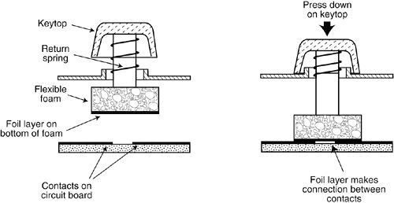
MECHANICAL SWITCHES

Slide 23
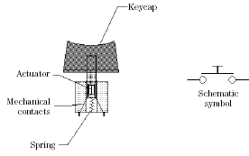
MECHANICAL SWITCHES
In mechanical switch keys two pieces of metals are pushed together when one presses the key.
The metal switch elements are often made of a phosphor- bronze alloy with gold plating on contact areas.
They contain a spring to return the key to the non-pressed
positioned a form to damp bouncing.

Slide 24
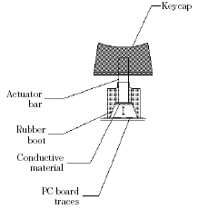
MEMBRANE KEY-SWITCHES
s
These are special types of mechanical switches. This consist
of 3 layers of plastic or rubber sandwiched as shown below.
When we press a key we push the top ink line through the
hole to contact the bottom ink line.
The advantage is that these types of key-switches can be
made very thin and sealed units. Lifetime of these key- switches vary over a wide range.

Slide 25
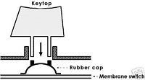
MEMBRANE KEY-SWITCHES

Slide 26
CAPACITATE KEY-SWITCHES
This type has two small metal plates on the PCB and another metal plate on the bottom of a piece of foam.
When we press a key the movable plate is pushed closer to the fixed plate & this changes the capacitance between the fixed plates.
The sense amplifier detects this change in capacitance
and produces a logic level signal indicating a key-press.
The advantage is the absence of mechanical contacts to be oxidized or dirty
And the only disadvantage is that a special circuitry is required to detect the change in capacitance. The lifetime is about 20 million keystrokes.

Slide 27
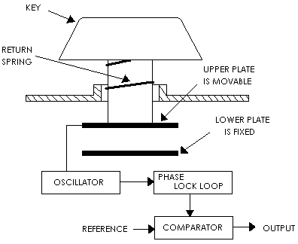

Slide 28
HALL EFFECT KEY-SWITCHES
This type also has no mechanical contacts.
It uses the principle of deflection of a moving change by a magnetic field.
When a key is pressed, the crystal is moved into a magnetic field, this has its flux lines perpendicular to the direction of current flow in the crystal.
This causes a small voltage to be developed between two of other opposing faces of the crystal. This indicated a key-press. It is more expensive but they are very dependable and have a lifetime of 100 million or more Keystrokes.

Slide 29
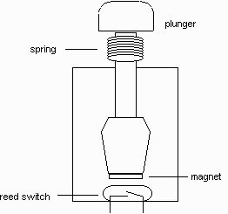
HALL EFFECT KEY-SWITCHES

Slide 30
KEYBOARD INTERFACE
It uses a special, dedicated interface to talk to the PC.
All keyboard uses the standard connectors to attach to the motherboard use the regular keyboard interface.
An alternative to the regular interface is to connect a USB keyboard to your USB-enabled PC.
The USB is not a keyboard interface at all, but general purpose, multi functional serial interface for all sorts of devices, from keyboard and mice to printers, scanners and even storage devices.

Slide 31
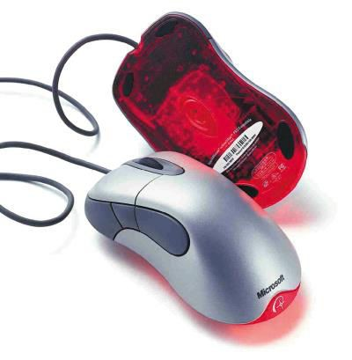
THE MOUSE - WHAT IS A MOUSE?
The mouse is a pointing device. You use it to move a graphical pointer on the screen.
The mouse can be used to issue commands, draw, and perform other types of input tasks.

Slide 32
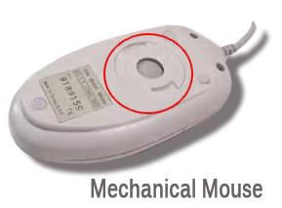
DIFFERENT TYPES OF MOUSE
Mechanical Mouse/ Ball Mouse
Mechanical mouse contains a rubber or metal ball inside it. The movement of the cursor depends on the movement of the ball.

Slide 33
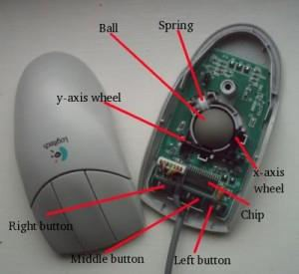

Slide 34
OPTOMECHANICAL / OPTICAL-MECHANICAL MOUSE
An Optomechanical or optical-mechanical mouse is same as the mechanical mouse except that the sensors used in it are optical and not mechanical.
The device is a combination of optical and mechanical technologies, wherein, the ball is present but the mouse movement is detected optically leading to more accuracy.

Slide 35
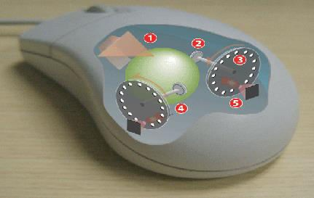

Slide 36
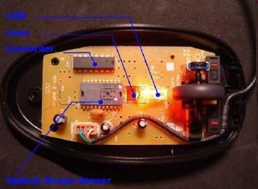
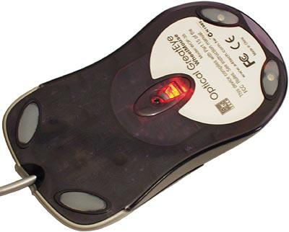
OPTICAL MOUSE
Light shown onto mouse pad
Reflection determines speed and direction
Requires little maintenance

Slide 37
WORKING OF OPTICAL MOUSE
Optical mouses do have an inbuilt optical sensor.
The optical sensor reads the movements of the optical mouse (moved by the user) with the help of the light rays which comes out from the bottom. ( The area in which a light glows).
When the user moves the optical mouse, the LED (Light Emitting Diode) present inside the mouse emits the light according the minute movements.
These movements are send to the camera as light rays. The camera captures the difference in light rays as images. When the camera captures the images, each and every pictures and compared to one another with the digital technology. With the comparison, the speed of the mouse and the direction of the movement of the mouse are rapidly calculated. According to the calculation, the pointer moves on the screen.
37

Slide 38
MOUSE INTERFACE TYPES
Serial interface
Dedicated motherboard (PS/2) mouse port
USB port

Slide 39

SERIAL INTERFACE:
popular method of connecting a mouse to older pcs is through the standard serial interface.
the connector on the end of the mouse cable is typically a 9-pin female connector; some very old mice used a 25 pin female connector.

Slide 40
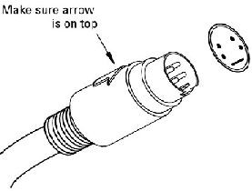
PS/2 MOUSE PORT:
PS/2 keyboard/mouse interface PS/2 was a type of personal computer produced by IBM in the 1980s.
a mini DIN connector, survives as the commonest connector for keyboards and mice.
The pin connections are identical for both devices and frequently the interface may be used for either device.
40

Slide 41
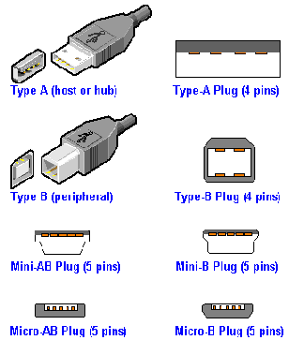
USB:
(Universal Serial Bus) A widely used hardware interface for attaching a maximum of 127 peripheral devices to a computer.
USB devices are "hot swappable;" they can be plugged in and unplugged while the computer is on.

Slide 42

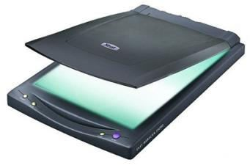

WHAT IS A SCANNER?
A scanner, simply put, is a device used to analyze an image and process it.

Slide 43
TYPES OF SCANNER
There are different types of scanners for different types of documents that need to be scanned.
Flatbed Scanners
Sheet-fed Scanners
Handheld Scanners
Drum Scanners

Slide 44
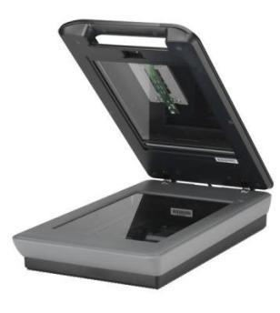
FLATBED SCANNER
Used for scanning most documents, photos, and even flat objects from a PC or laptop.
Flatbed scanner works like a
copy machine.
Scans documents placed face down on the glass (scan bed)
Most common type of scanner.

Slide 45
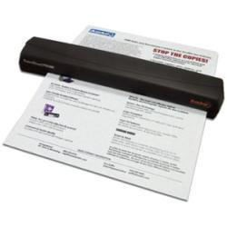
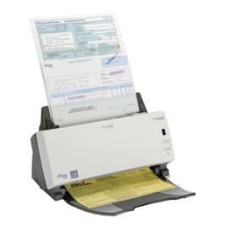
SHEET-FED SCANNER
More portable than a flatbed scanner.
Used to scan paper documents and photos.
The paper moves through
the scanner.
Usually smaller than a flat- bed and portable.

Slide 46
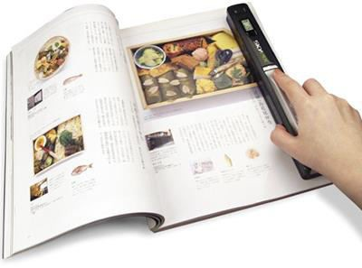
HANDHELD SCANNER
Smaller than the previous two scanners.
The user must move the scanner across the document.
Image quality us usually
lower.

Slide 47
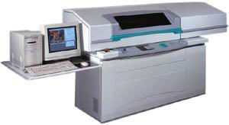
DRUM SCANNER
Used by the publishing industry.
Document is placed on a glass cylinder.
Generates very high quality scans.

Slide 48
SCANNER SOFTWARE
The TWAIN is a standard of communication between the computer and scanner that all scanner manufacturers agree to that allow images to be directly scanned from an image editing program.
The TWAIN driver controls the scanner and serves as the interface between the scanner and your graphics program.

Slide 49
WHAT IS TWAIN?
Twain is an old form of the word “two”.
The TWAIN software refers to the computer and scanner and the difficulty in connecting the two.
The developers took the word from Kipling's "The Ballad of East and West"
"...and never the twain shall meet...",
Allows 3rd party software applications to access the scanner to import images.

Slide 50
WHAT IS A PRINTER?
An external hardware device responsible for taking computer data and generating a hard copy of that data. Printers are one of the most commonly used peripherals and they print text and still images on the paper.

Slide 51
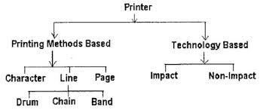
CLASSIFICATION OF PRINTER

Slide 52
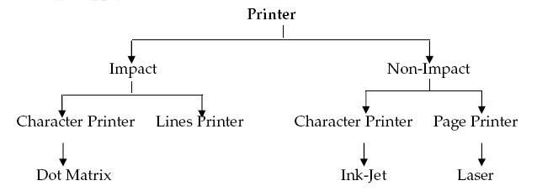

Slide 53
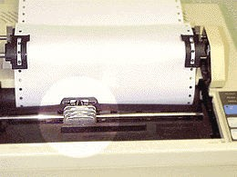
IMPACT PRINTER
These printers have a mechanism that touches the paper to create an image. These printers work by banging a print head containing a number of metal pins which strike an inked ribbon placed between the print head and the paper.
53

Slide 54
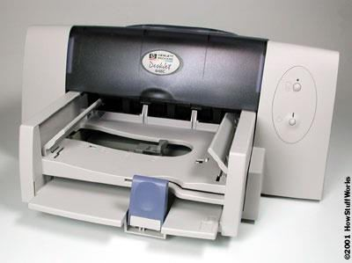
NON-IMPACT PRINTERS
These printers create an image on the print medium without the use of force. They don’t touch the paper while creating an image. Non-impact printers are much quieter than impact printers as they don’t strike the paper

Slide 55
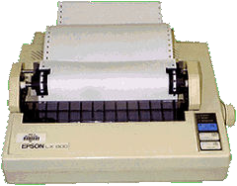
“DOT MATRIX PRINTER”
The term dot matrix refers to the process of placing dots to form an image.
Its speed is usually 30 to 550 characters per second (cps).
This is the cheapest and the most noisy printer and has a low print quality. Dot Matrix were 1st introduced by Centronics in 1970.

Slide 56
ADVANTAGES/DIS-ADVATAGES OF DOT- MATRIX
Advantages:
In-expensive.
Low per page cost.
Energy efficient.
Dis-advantages:
Noisy
Low resolution
Limited fonts flexibility
Poor quality graphics output.

Slide 57
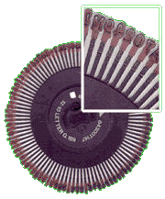
DAISY WHEEL PRINTER
A daisy wheel printer is basically an impact printer consisting of a wheel and attached extensions on which molded characters are mounted. A daisy wheel printer produces letter quality print and it can’t produce graphics output.

Slide 58
INK-JET PRINTER
It is a non-impact printer producing a high quality print.
A standard Inkjet printer has a resolution of 300dpi. Newer models have further improved dpi.
Inkjet printers were introduced in the later half of 1980s and are very popular owing to their
extra-ordinary performance.

Slide 59
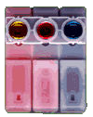
HOW INKJET PRINTER WORKS?
Print head having four ink cartridges moves .
Software instructs where to apply dots of ink, which color and what quantity to use.

Slide 60
ADVANTAGES/DIS-ADVANTAGES
Advantages:
High resolution output.
Energy efficient.
Many options to select.
Dis-advantages:
Expensive.
Special paper required for higher resolution output.
Time consuming in case of graphics printing.

Slide 61
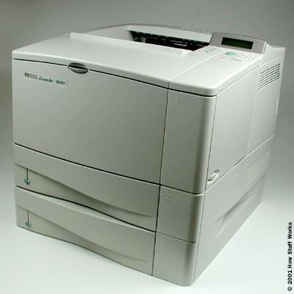
“LASER PRINTER”
Laser printers use very advanced technology and produce a high quality output. Laser printers can also produce high quality graphics images.
Resolution is 600 to 1200dpi.

Slide 62
HOW LASER PRINTER WORKS?
(1) Paper is fed and the drum rotates.
(2) A laser beam conveys information from the computer to a rotating mirror and thus an image is created on the drum.
(3)The charges on the drum are ionized and the toner sticks to the drum.
(4)Toner is transferred from drum to paper.
(5)Heat is applied to fuse the toner on the paper.
62

Slide 63
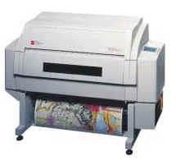
“PLOTTER”
A large scale printer which is very accurate in producing engineering drawings and architectural blueprints.
Two types of plotters are
flatbed and drum.
Flatbed plotters are horizontally aligned while drum plotters are vertically positioned.
63

Slide 64
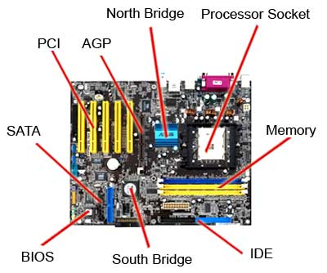
The Parts of a Computer Motherboard

Slide 65
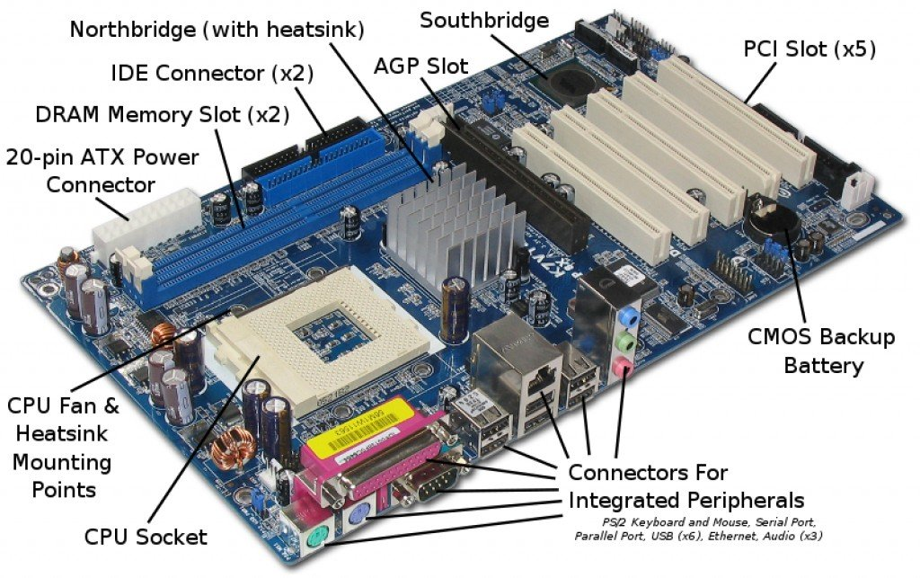
Major Motherboard Components and Their Functions

Slide 66
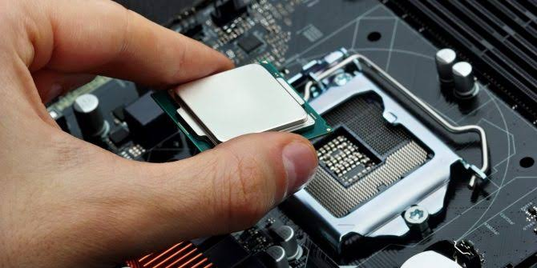
CPU SOCKET

Slide 67
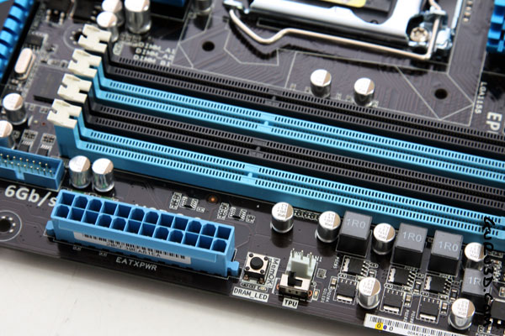
MEMORY SLOT

Slide 68
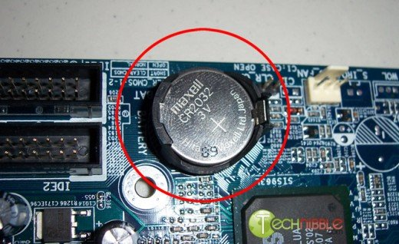
CMOS

Slide 69
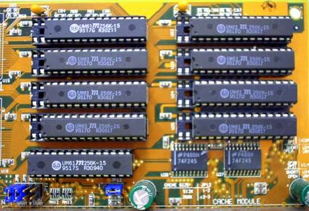
Cache memory

Slide 70
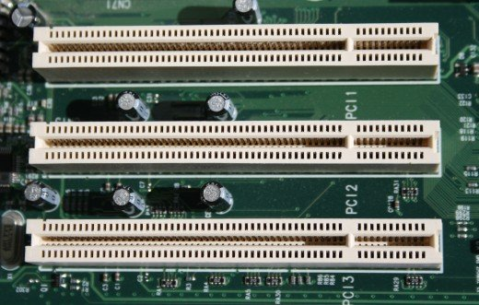
Expansion bus

Slide 71
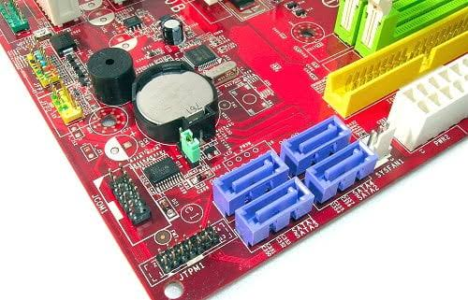
IDE or SATA

Slide 72
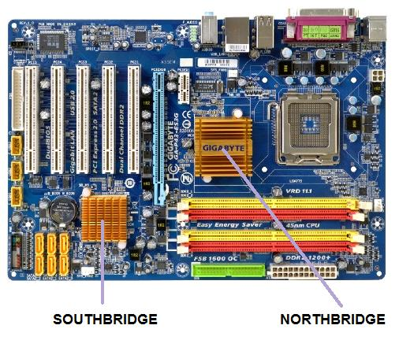

Slide 73
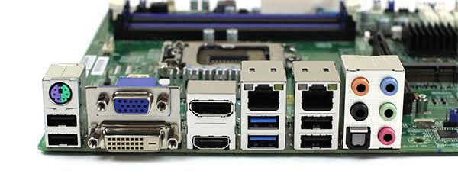

Slide 74
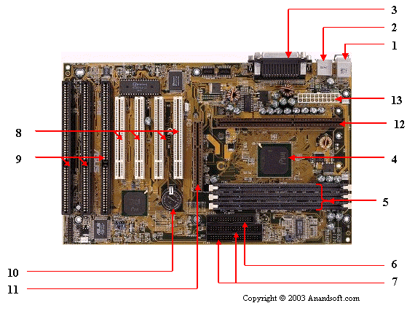
1. Mouse & keyboard 2. USB 3. Parallel port 4. CPU Chip 5. RAM slots 6. Floppy controller 7. IDE controller 8. PCI slot 9. ISA slot 10. CMOS Battery 11. AGP slot 12. CPU slot 13. Power supply plug in

Slide 75
1. Mouse & keyboard
2. USB
3. Parallel port
4. CPU Chip
5. RAM slots
6. Floppy controller
7. IDE controller
8. PCI slot
9. ISA slot
10. CMOS Battery
11. AGP slot
12. CPU slot
13. Power supply plug in

